Slide 1


Slide 2


X
Mbalenhle B. Holt | Pengrui Zeng | Pranav Naik | Abhineet Chaudhary | Chitra R. Krishnarao
Faculty Advisor: Allison Sagraves
Capstone Project Fall 2024
December 10, 2024 - Final Presentation
Notes:
MBALI

Slide 3
Agenda
Introduction
Team Members
Scope
Background, Scope, Purpose, Business Impact
Timeline
Project Management, Meetings, Communication
Research
Dimensions, Framework & Recommendations
Conclusion
Challenges, Lessons Learned, Q&A
Notes:
MBALI

Slide 4





Team Members
Mbalenhle B. Holt
Chitra R. Krishnarao
Pengrui Zeng
Abhineet Chaudhary
Pranav Naik
Master of Information Systems Management
Master of Information Systems Management BIDA
Master of Information Systems Management
Master of Information Systems Management
Master of Information Systems Management
Notes:
ALL

Slide 5

Background
Tata Consultancy Services (TCS) is an Indian multinational information technology (IT) company headquartered in Mumbai, India, provides IT, consulting, and business-related solutions to some of the world’s largest companies.
Through their impressive portfolio, TCS has established themselves as a significant benchmark for software development in the industry through its Location Independent Agile delivery model.
Notes:
RAY

Slide 6
Background Continued
TCS is apart of the Tata Group which serves as India’s largest multinational business group.
Currently operates in approximately 150 locations that span across 46 countries with over 600,000 employees.
Serves as the second largest Indian company by market capitalization
Ranked seventh on the Fortune India 500 list 2024
Over 1,000 clients globally
Notes:
RAY

Slide 7








TCS Partners & Clients
Some notable partnerships and clients of TCS that the consultancy service provides strategic advisement to include...
Notes:
RAY

Slide 8
Problem Statement
“Performance benchmarking is a practice of comparing business performances and processes against industry standards. By identifying the best practices for performance benchmarking, the students must develop a framework to improve the organization's current benchmarking analysis techniques.”
Notes:
RAY

Slide 9
Scope
“The objective of the project is to curate a benchmarking framework to uncover insights that are not considered in current benchmarking analysis. The goal is to build a novel framework that introduces a new methodology to the practice that will ultimately improved business performances with the focus on IT Infrastructure benchmarking.”
Notes:
RAY

Slide 10
Purpose
Why?
Notes:
CHITRA
Next, we’ll be talking about why we we’re building the performance benchmarking tool.

Slide 11
Purpose Continued
Eliminate Manual Errors
Ensures no KPIs or metrics are overlooked, avoiding costly manual mistakes and test redesigns.
03
Comprehensive Research for KPIs
KPIs vary depending on the domain within the selected industry, ensuring that each performance metric is tailored to its specific context.
01
02
Prevent the Duplication of Tasks
Once the KPIs for a particular industry are determined, they only need periodic updates, avoiding repetitive efforts in re-establishing metrics.
Notes:
CHITRA

Slide 12
Business Impact
How?
Notes:
CHITRA
Business Impact focuses on how the tool will be beneficial to its clients or organizations.

Slide 13
Business Impact Continued
Competitive Advantage
Continuous monitoring of performance metrics helps organizations identify improvement areas swiftly, ensuring they remain ahead of industry trends.
Increased Operational Efficiency
Automating research and testing streamlines operations, minimizing manual intervention and reallocating resources to high-priority tasks.
04
01
03
Cost Savings & Resource Optimization
By eliminating manual errors and redundant processes, organizations achieve significant cost savings and optimize manpower usage.
Enhanced Strategic Planning
Actionable insights that empower companies to align their improvement strategies with industry benchmarks and long-term goals.
02
Notes:
CHITRA

Slide 14
Project Management Timeline
Kick-Off Meeting with TCS
Exploratory Phase & Practice Presentation
Developmental Phase
Week 2
Week 6 - 7
Week 13 - 14
Week 1
Week 3 - 5
Week 8 - 12
Completion of the Critical Thinking Exercise
Selection of a Benchmark Focus Area & Midterm Presentation
Finalization Phase & Final Presentation
Notes:
MBALI

Slide 15
Project Progression
Framework
Messaging
Research
Meetings
Introduction
Kick-off meeting & introduction to the project
Weekly meetings with CMU team and client throughout the semester
Deep dive into IT Infrastructure benchmarking & the identification of novelty insights
Back-and-Forth communications via email & WhatsApp
Final Framework Development & Recommendation
Notes:
MBALI
Several steps were taken throughout the semester to arrive at the position we are at today.
Through back and forth messaging, weekly meetings, and significant research of IT Infrastructure benchmarking and its dimensions we are able to propose several recommendations for our benchmarking framework. Each member of the team will discuss each dimension and our final recommendation for each throughout today’s presentation.

Slide 16
IT Infrastructure Benchmarking
“A multifaceted practice that provides a perspective to inform organizations to better understand where their IT infrastructure performances and capabilities lie compared to industry leaders in respect to the digital maturity curve.”
Trianz
Trianz - IT Infrastructure Competitive Benchmarking
Notes:
Speaker: ABHINEET

Slide 17
IT Infrastructure Dimensions
Process
Involve structured activities to manage, maintain, and optimize an organization's technological environment.
Cost Efficiency
Optimizing resources and investments to achieve maximum performance and scalability at the lowest possible cost.
04
01
03
Workforce Productivity
Focuses on enabling employees to perform efficiently by providing reliable, secure, and high-performing technological resources.
Security
Ensures the protection of data, systems, and networks against unauthorized access, breaches, and cyber threats.
02
Notes:
Speaker: ABHINEET

Slide 18
Cost Efficiency
“Benchmarking cost efficiency involves comparing the expenses of IT infrastructure, including hardware, software, and operational costs, against industry standards. This process identifies areas for cost optimization while maintaining or improving performance and scalability.”

Slide 19
Cost Efficiency - GenAI Use-Cases
Innovation Enablement: Powers ideation and problem-solving, offering creative approaches to product design, marketing strategies, and more
Market Growth: The Generative AI market is expected to show an annual growth rate (CAGR 2024-2030) of 46.47%, resulting in a market volume of US $356.10 bn by 2030
Competitive Advantage: Early adopters gain a strategic edge, leveraging GenAI to outpace competitors in innovation, personalization, and operational efficiency
Diverse Use Cases: Image and Video Synthesis for Marketing, Automated Code and Application Development, Customer Service Chatbots and Virtual Assistants, Content Generation and Personalization, Real-Time Language Translation
Notes:
Speaker: ABHINEET

Slide 20
Return-on-Investment (ROI)
Recognizing Investment
Metric Variations
Quantifying Profit
Market Conditions
Factors affecting GenAI ROI
Analyzing Improvement
Notes:
Speaker: ABHINEET
Referenecres: 1. https://www.investopedia.com/terms/r/returnoninvestment.asp
2. https://www.analyticsvidhya.com/blog/2024/10/roi-of-genai-investments/
3. https://www.pwc.com/gx/en/issues/technology/path-to-generative-ai-value.html
4. https://isg-one.com/articles/index-insider--generative-ai-use-cases---where-s-the-top-line

Slide 21
Cost Dimensions for AI Use-Cases
Implementation
Operations
Model Training
Data
Inference
Time-to-deploy (hours) [ScaleUpAlly]
Infrastructure setup costs ($) [Gartner]
Development Time (hours) [Simublade]
Adoption rate (%) [Gartner]
Average wage per hours ($) [Gartner]
Monthly maintenance cost ($) [ITRex]
Infrastructure operating cost ($) [Gartner]
Licensing cost ($)
[TristateTechnology]
Cost per training iteration ($) [Forbes]
GPU/TPU usage cost ($) [Forbes]
Total usage hour per iteration ($) [Forbes]
Data acquisition cost ($) [Deloitte]
Data storage cost per month ($) [Deloitte]
Cost per inference ($) [Forbes]
Total number of inference (count) [Gartner]
Total operational inference cost ($) [Gartner]
Notes:
Speaker: ABHINEET
Referenecres: 1. https://www.gartner.com/en/documents/5188263 [Gartner]
2. https://scaleupally.io/blog/cost-to-build-generative-ai/ [ScaleUpAlly]
3. https://www.simublade.com/blogs/cost-to-develop-a-generative-ai-app/#Generative_AI_app_development_cost [Simublade]
4. https://itrexgroup.com/blog/calculating-the-cost-of-generative-ai/ [ITRex]
5. https://www.tristatetechnology.com/blog/ai-app-development-cost-breakdown [TristateTechnology]
6. https://www.forbes.com/sites/katharinabuchholz/2024/08/23/the-extreme-cost-of-training-ai-models/ [Forbes]
7. https://dart.deloitte.com/USDART/home/publications/deloitte/industry/technology/accounting-generative-ai-software-products [Deloitte]

Slide 22
Success Indicators for Gen AI Use Cases
Competitive Advantage
Revenue
05
- Monetized API usage ($) [NetworkComputing]
- Total API calls (count)
[NetworkComputing]
- Product monthly subscription fees ($) [Google]
- Model-driven product sales ($)
[Google]
- First-to-market innovation revenue ($) [McKinsey]
- Market share gain ($)
[McKinsey]
- Industry total revenue ($)
[McKinsey]
01
04
User Retention
Cost Savings
- Customer Lifetime Value (CLV) ($)
[Google 2]
- Number of retained users (count) [Google 2]
- Number of churned users (count) [Google 2]
- Reduced operational costs ($)
[MultiModal]
- Reduced workforce expenditure ($)
[MultiModal]
- Decreased data processing costs ($)
[MultiModal]
02
03
Market Growth
- Customer acquisition rate per year (%) [Revvence]
- Increased product adoption revenue ($) [Revvence]
Notes:
Speaker: ABHINEET
Referenecres: 1. https://www.networkcomputing.com/ai-networking/apis-the-key-to-generative-ai-success-and-security [NetworkComputing]
2. https://cloud.google.com/transform/kpis-for-gen-ai-why-measuring-your-new-ai-is-essential-to-its-success [Google]
3. https://www.multimodal.dev/post/ai-kpis [MultiModal]
4. https://www.mckinsey.com/capabilities/mckinsey-digital/our-insights/the-economic-potential-of-generative-ai-the-next-productivity-frontier#introduction [McKinsey]
5. https://cloud.google.com/ai-platform/docs/clv-prediction-with-offline-training-train [Google 2]
6. https://revvence.com/blog/a-metrics-driven-approach-to-evaluating-genai-use-cases-in-the-finance-function [Revvence]

Slide 23
Calculating Total Cost for Gen AI Use-cases
Implementation Cost = ((Time-to-deploy (hours) + Development Time (hours)) × Average Wages per Hour ($)
+ Infrastructure Setup Costs ($)) × (Adoption Rate (%) / 100)
Operational Cost (Yearly) = ( Monthly maintenance cost + Infrastructure operating cost ) × 12 + Licensing cost
Model Training Cost = Cost per training iteration × Number of iterations
+ ( GPU/TPU usage cost/hour × Total usage hours per iteration )
Data Cost = Data acquisition cost + ( Data storage cost × 12 )
Inference Cost = (Cost per inference × Total number of inferences) + Total operational inference cost
Total Cost of Investment ($) = Implementation Cost + Operational Cost
+ Model Training Cost + Data Cost + Inference Cost
Notes:
Speaker: ABHINEET
Derived from metrics discovered from our research
As new metrics are discovered, we would need to adjust above formulas accordingly

Slide 24
Calculating Profit Potential for Gen AI Use-cases
Revenue ($)= (Monetized API usage ($) × Total API calls (count)) + (Product monthly subscription fees ($) × 12)
+ Model-driven product sales ($)
Cost Savings ($)= Reduced operational costs ($) + Reduced workforce expenditure ($) + Decreased data processing costs ($)
Market Growth ($)= (Customer acquisition rate per year × CLV) + Increased product adoption revenue
User Retention ($)= ( CLV × Number of retained users) − ( CLV × Number of churned users)
Competitive Advantage ($)= First-to-market innovation revenue ($) + Market share gain (%) × Industry total revenue ($)
Estimated Total Revenue ($)= Revenue + Cost Savings + Market Growth
+ User Retention + Competitive Advantage
Notes:
Speaker: ABHINEET
Derived from metrics discovered from our research
As new metrics are discovered, we would need to adjust above formulas accordingly

Slide 25
Calculating Return-on-Investment (ROI)
Notes:
Speaker: ABHINEET
Latex Equation: \text{ROI} = \frac{\left( \text{Revenue} + \text{Cost Savings} + \text{Market Growth} + \text{User Retention} + \text{Competitive Advantage} \right) - \left( \text{Implementation Costs} + \text{Operational Costs} + \text{Model Training Costs} + \text{Data Costs} + \text{Inference Costs} \right)}{\left( \text{Implementation Costs} + \text{Operational Costs} + \text{Model Training Costs} + \text{Data Costs} + \text{Inference Costs} \right)} \times 100

Slide 26
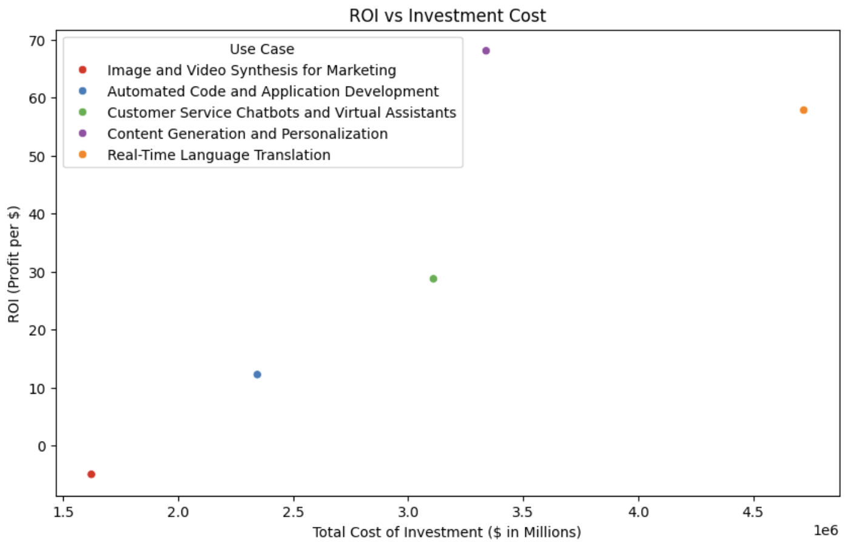
Deriving Insights using ROI: Scatter-plot
How to Visualize:
X-axis: Total Cost of Investment
Y-axis: ROI
Insights for IT Executives:
Invest in Technology with highest ROI potential
Notes:
Speaker: ABHINEET
Link to Codebase:

Slide 27
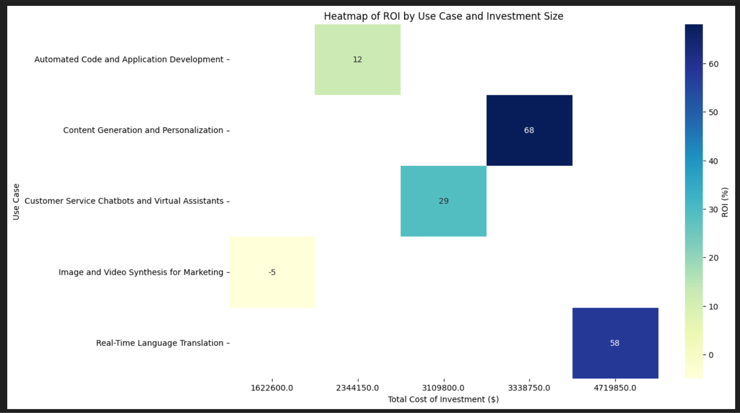
Deriving Insights using ROI: HeatMap
How to Visualize:
X-axis: Total Cost of Investment
Y-axis: Use Case
Gradation from Purple (Positive ROI) to Yellow (Negative ROI)
Insights for IT Executives:
Technologies with the highest ROI (dark purple areas) highlight the most profitable investments
Negative ROI (bright yellow) signals areas to avoid or reconsider
Notes:
Speaker: ABHINEET
Link to Codebase:

Slide 28
AI in Workforce Productivity
“Benchmarking workforce productivity for IT infrastructure evaluates the efficiency and output of IT teams in managing, maintaining, and optimizing infrastructure. Highlights areas where productivity may be improved to ensure organizational goals are met by the allocation of skills, automation of repetitive tasks, and enhancement of the overall IT service delivery,.”

Slide 29





AI in Workforce Productivity
Rapid evolution of AI tools transforming operations, decision-making, customer engagement.
Businesses face a fragmented landscape of AI solutions with varied costs, benefits, and impacts.
Notes:
PRANAV

Slide 30
The Need For a Framework
Challenge: Absence of a standardized evaluation framework for selecting AI tools aligned with business goals.
Objective: Build a robust, adaptable framework to measure and compare AI tools based on operational, financial, and experiential metrics for organizations like TCS which have multiple moving and interacting parts.
Notes:
PRANAV

Slide 31
Framework Overview
To provide a structured approach to identify the best AI tools for workforce productivity, we should look at the following Key Evaluation Dimensions:
Cost Metrics – Evaluate financial feasibility and ROI.
Operational Metrics – Measure task efficiency and error reduction.
Employee Experience Metrics – Assess adoption and satisfaction.
Customer Impact Metrics – Gauge improvements in customer engagement.
Category-Specific Metrics – Tailored to the use case of the AI tool (Generative AI, Business Automation, CRM).

Slide 32
Key Metrics and Their Relevance
Granular Metrics:
Error Reduction Ratio (ERR): Measures operational reliability.
Adoption Velocity (AV): Reflects ease and speed of tool adoption.
Employee Satisfaction Gain (ESG): Indicates tool impact on workplace morale.
Customer Experience Improvement (CXI): Tracks downstream effects on customers.
Cost Efficiency Index (CEI): Quantifies financial ROI.
Category-Specific Metrics:
Generative AI: Accuracy, multi-modality, and safety.
Business Automation: Integration, low-code interfaces, and RPA impact.
Customer Relation Management: Customer retention, pipeline efficiency, and engagement scores.

Slide 33
Analytical Approach
How the Framework Works:
Metrics are calculated for each tool to identify trends and gaps.
Granular insights (e.g., reduction in manual errors or faster task completion) complement broader perspectives (e.g., overall ROI).
Focus Areas:
Highlight areas where AI tools show significant performance improvements.
Identify trade-offs, such as higher costs vs. operational benefits.
Example Scenarios:
Generative AI: Balancing accuracy with efficiency in content creation.
Automation Tools: Comparing integration capability with cost-efficiency.

Slide 34
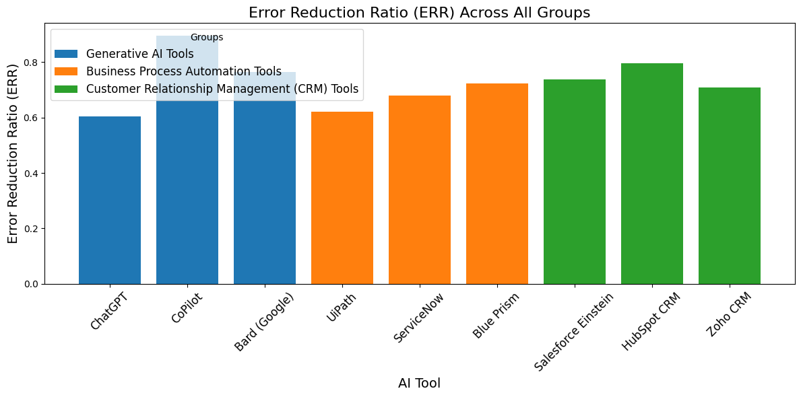
Visualizations of Metrics - Categorical

Slide 35
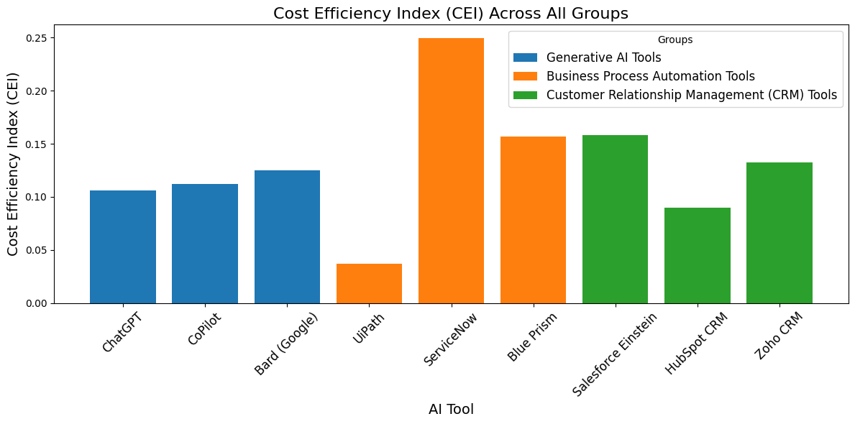
Visualizations of Metrics - Categorical

Slide 36
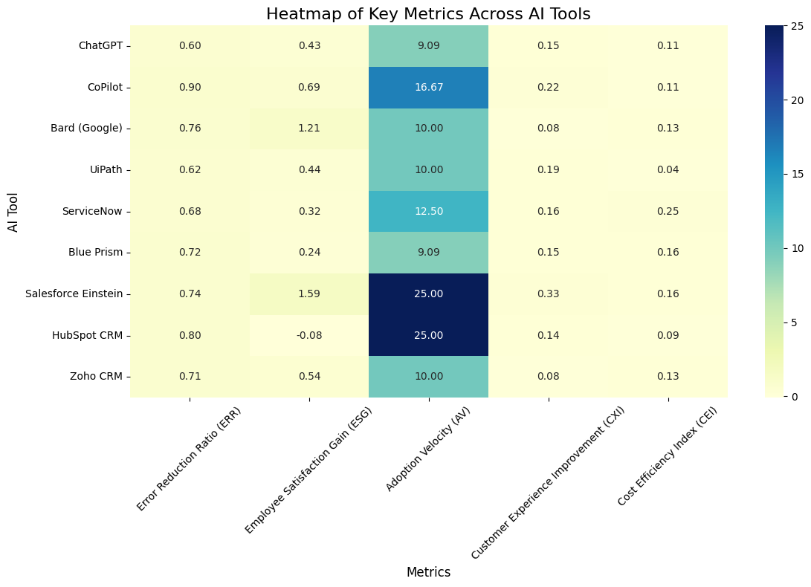
Metric Heatmap
Focus on tools with high metric scores aligned to your organizational priorities.
Use darker cells in critical areas to shortlist tools for deeper evaluation.
Identify tools with balanced performance across metrics for multi-functional use cases.

Slide 37

Actionable Recommendations
Pilot High-Performing Tools: Start with tools that align with your organization’s immediate priorities, such as customer experience enhancement or operational reliability.
Focus on ERR and CEI Metrics: Prioritize tools that reduce errors and deliver high ROI to maximize both operational and financial benefits.
Customize Implementations: Leverage tools with strong category-specific strengths—whether for generative AI, process automation, or CRM workflows.
Iterate and Scale: Use real-world feedback to refine the framework and scale successful implementations across the organization.

Slide 38
Process
Data Management
IT Infrastructure Processes
Asset Management
Notes:
MBALI
Next, Ray and I will be discussing the Process dimension within IT Infrastructure:
It breaks down into two areas: Data Management and Asset Management

Slide 39
Data Management
“Benchmarking data management processes, organizations can align their practices with best standards to enhance operational efficiency, cost-effectiveness, and security while establishing scalable data handling solutions.”
Notes:
MBALI
In the digital era, effective data management processes are vital for ensuring organizational success. Therefore, these processes encompass data storage, processing, access, and security, all of which directly impact operational efficiency, decision-making, and compliance. Benchmarking in this area enables organizations to:
Identify gaps in current practices compared to industry leaders.
Optimize decision-making regarding storage solutions, data governance, and scalability.

Slide 40
Benchmark Use Case
Data Storage Utilization & Recovery Time
Notes:
MBALI
For the purpose of this project, the specific data management use case focuses on data storage utilization & recovery time
Benchmarking these metrics provides organizations with the ability to:
Compare their performance against industry standards and market competitors.
Identify inefficiencies or risks in their current data management processes.
Support decision-making for capacity planning, system upgrades, or cost management.
Ensure operational resilience, data accessibility, and compliance with business continuity standards.
By monitoring and optimizing these metrics, organizations can achieve scalable, secure, and cost-effective data management solutions.

Slide 41
Target Value
70-80%
<20ms
<1hr
Storage Utilization Rate (%)
Access Latency (ms)
Recovery Time Objective (RTO)
Measures the proportion of allocated storage actively in use.
The speed at which data is retrieved from storage systems.
Measures the time required to restore data systems after an outage.
Low Utilization = over-provision or underutilization of resources
High Utilization = risks of storage saturation
High Latency = inefficiencies in storage configurations or network bottlenecks
Low Latency = efficient operations & better user experience
High RTO = inadequacies in backup or recovery processes
Low RTO = enhances operational resilience & minimizes financial loses
Reference: Implement Efficient Data Storage Measures (Energy Star)
Reference: Latency Critical Big Data Computing (Sciencedirect)
Reference: RTO and RPO (Commvault)
Notes:
MBALI
Next, we focused on three specific metrics:
Storage Utilization Rate
Access Latency
Recovery Time Objective (RTO)
Storage Utilization Rate - Measures the proportion of allocated storage actively in use.
Access Latency - The speed at which data is retrieved from storage systems.
Recovery Time Objective (RTO) - Measures the time required to restore data systems after an outage.
Our target benchmarks for each are 70-80% storage utilization, less than 20 ms for access latency, less than an hour for recovery time objective.
When it comes to decision-making several inferences have been made
Storage Utilization Rate:
Low Utilization: Suggests over-provisioning or underutilized resources requiring redistribution.
High Utilization: Highlights risks of storage saturation, necessitating capacity expansion or optimization.
Access Latency
High Latency: Indicates inefficiencies in storage configurations or network bottlenecks.
Low Latency: Ensures smooth operations and better user experiences.
Recovery Time Objective
High RTO: Signals inadequacies in backup or recovery processes.
Low RTO: Enhances operational resilience and minimizes financial losses during disruptions.

Slide 42
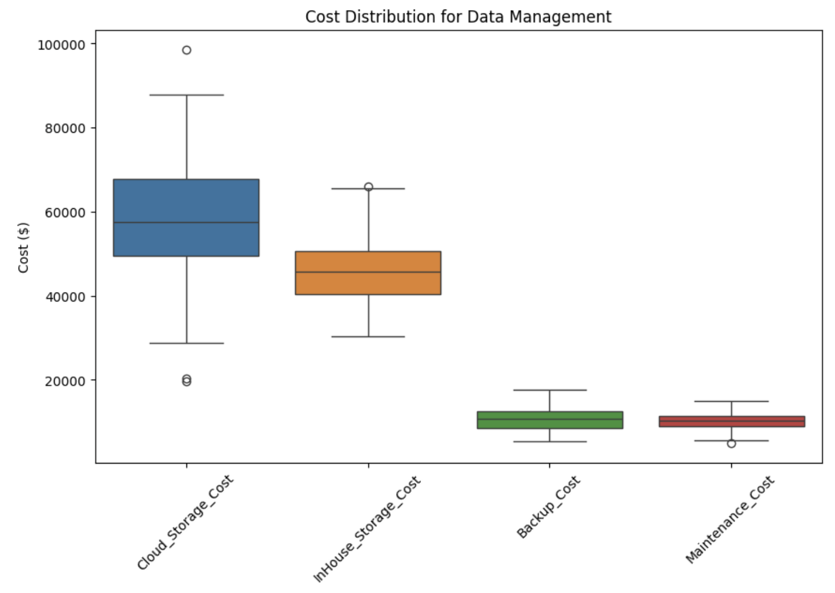
Data Visualization
Box Plot: Cost Distribution
Boxplot that shows the distribution of costs associated with four key areas of data management: Cloud Storage Cost, In-House Storage Cost, Backup Cost, and Maintenance Cost.
*utilized synthetic data
Notes:
MBALI
Insights:
Cloud Storage and InHouse Storage costs are the largest contributors to overall costs, with higher medians and variability compared to Backup and Maintenance costs.
Cloud Storage costs exhibit more outliers and variability than InHouse Storage, suggesting that costs can fluctuate significantly depending on the setup or scale of use.
Backup and Maintenance costs are relatively stable, with smaller ranges and fewer outliers.

Slide 43
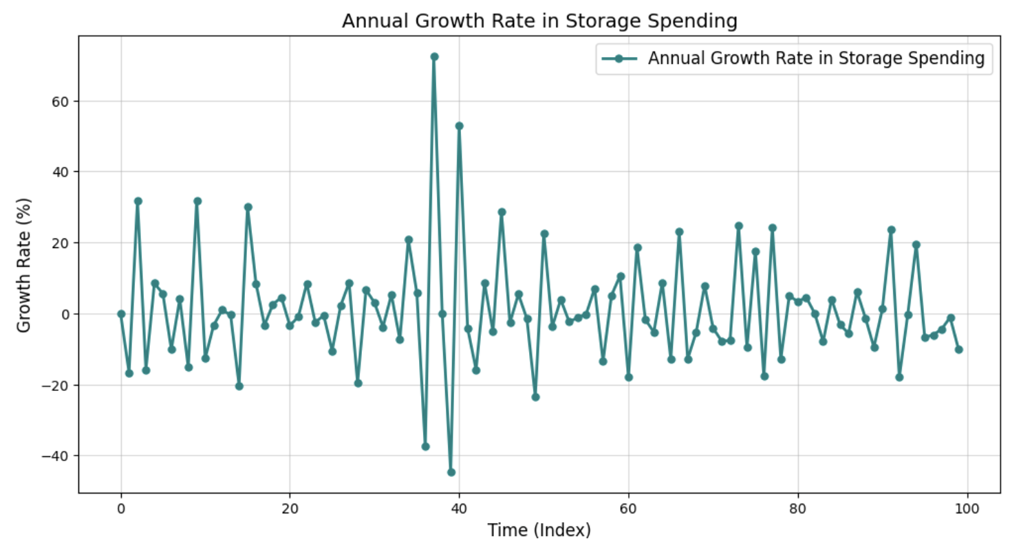
Data Visualization
Line Plot: Annual Growth Rate in Storage Spending
The line graph presents an illustration of the annual growth rate in storage spending. The volatility and lack of a clear trend highlight the complexity of storage investment decisions and the need for careful analysis to understand the underlying drivers and potential future trajectories.
*utilized synthetic data
Notes:
MBALI
This graph displays the annual growth rate in storage spending over a time period. Key insights that can be drawn from the data include:
Volatility in Growth Rates: The graph shows significant fluctuations in the annual growth rate, indicating periods of both rapid increases and decreases in storage spending. Peaks and troughs may correlate with external factors like changes in business priorities, economic conditions, or technological advancements.
Lack of a Clear Trend: Over time, there doesn't seem to be a consistent upward or downward trend, which may imply that storage spending is highly reactive to short-term needs or external pressures rather than driven by a steady growth strategy.
Potential Areas for Analysis: The most extreme peaks and dips could warrant further investigation to identify their causes, which may help to understand patterns and make more predictable budgeting or investment decisions in the future.

Slide 44
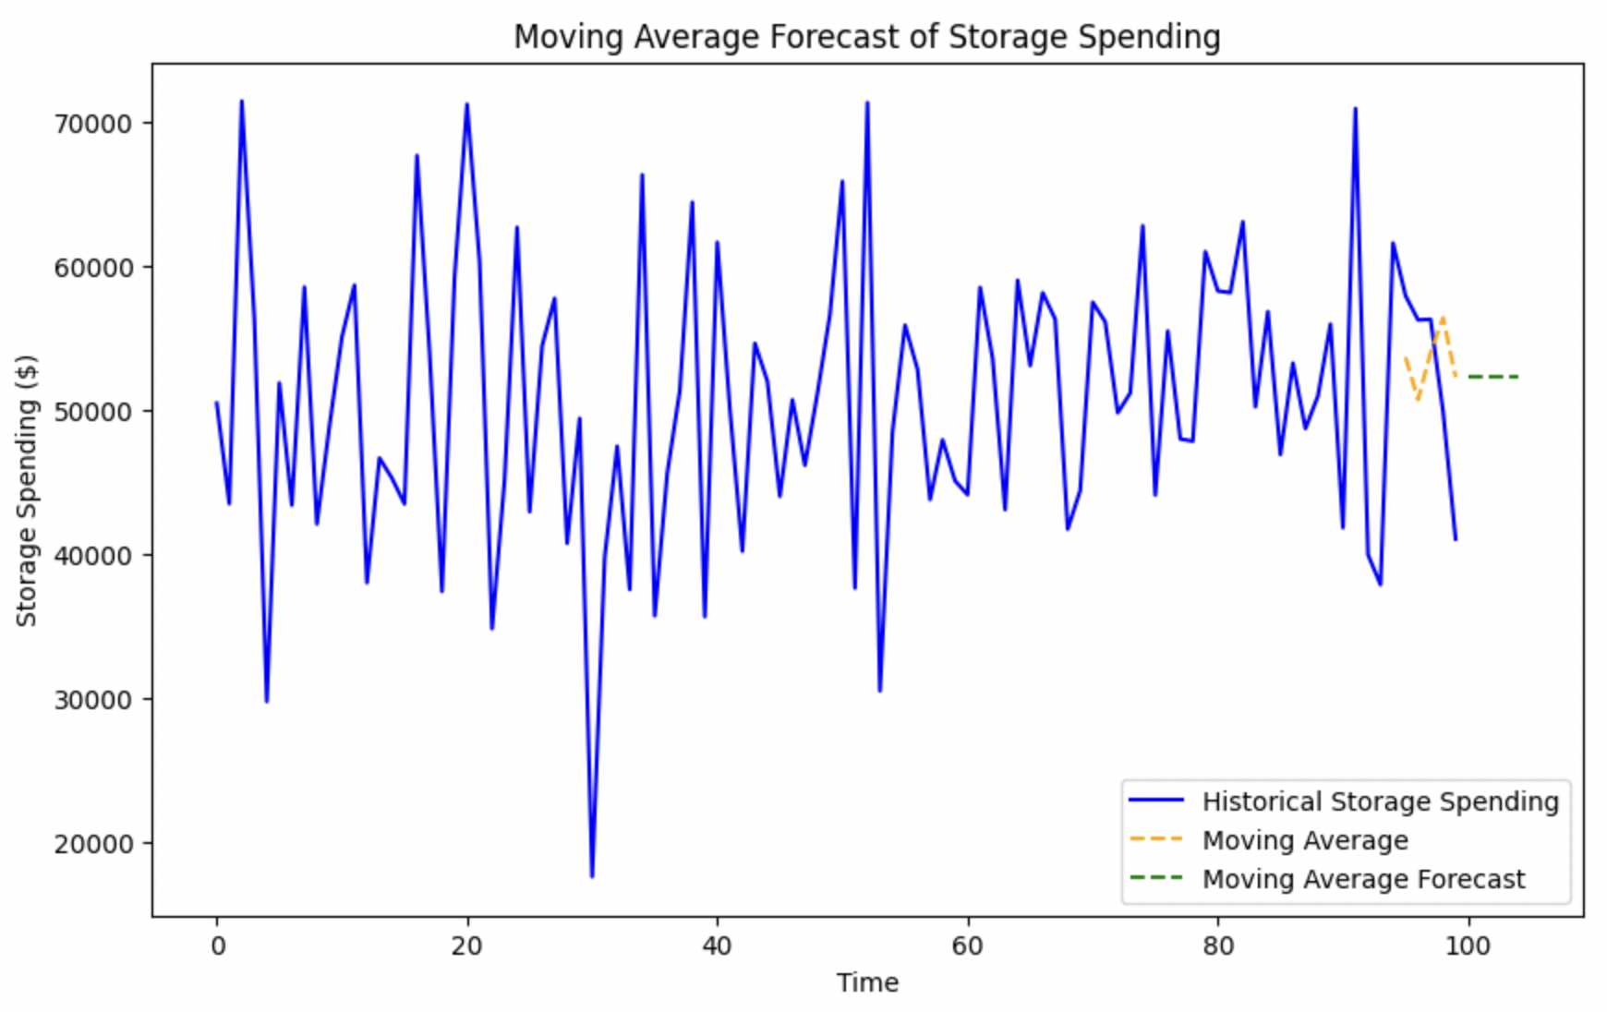
Data Visualization
Line Plot: Forecast of Storage Spending
The graph shows a historical trend of fluctuating storage spending. The moving average forecast suggests a potential upward trend in storage spending in the near future. However, the simple moving average model may not capture complex patterns or sudden changes in spending.
*utilized synthetic data
Notes:
MBALI
This graph shows historical storage spending with a moving average forecast over time.
Some key insights include:
Volatile Historical Spending: The blue line represents substantial fluctuations in storage spending over time which suggests that storage demands or budgeting priorities have been inconsistent.
Smoothing Effect of Moving Average: The orange dashed line (moving average) smooths out short-term fluctuations which reveals that there is a underlying trend.
Forecast Stability: The green dashed line (moving average forecast) projects future spending based on historical data. It’s a relatively stable forecast which indicates an expectation of reduced volatility, thus we can assume that current trends will persist.
Potential Budgeting Insight: The smoothing and forecast suggest opportunities to stabilize storage spending by analyzing peak spending periods and addressing inefficiencies.

Slide 45
Optimization Strategies - Recommendation
01
Use automated solutions to tier data based on access frequency for storing hot data in high speed systems and cold data in cost-efficient storage.
Dynamic Data Tiering
02
Employ machine learning to forecast storage requirements, enabling proactive capacity adjustments, and avoid over-provisioning.
Predictive Storage Scaling
03
Deploy real-time monitoring tools to track storage usage and latency.
Real-Time Monitoring & Alerts
Notes:
MBALI
We proposed several optimization strategies as final recommendations for data management they include:
Dynamic Data Tiering
Predictive Storage Scaling
Real-TIme Monitoring & Alerts

Slide 46
Asset Management Use Case
Asset Utilization Rate & Downtime Rate
Notes:
RAY

Slide 47
Target Value
75-85%
<5%
Asset Utilization Rate (%)
Downtime Rate (%)
Measures how effectively an asset is being used relative to its total available time
Measures the percentage of time an asset is not operational due to failures or maintenance
Low Utilization = inefficiencies and increased operational costs due to over-provisioning.
High Utilization = risks of system overloading, and system outages
Reference: Deloitte IT Asset Management Survey 2023 (Deloitte, 2023).
Low Rate = highly efficient and reliable systems.
High Rate = Frequent outages, leading to operational inefficiencies, financial losses, and reduced trust.
Reference: Gartner IT Infrastructure Report (Gartner, 2023).
Notes:
RAY

Slide 48
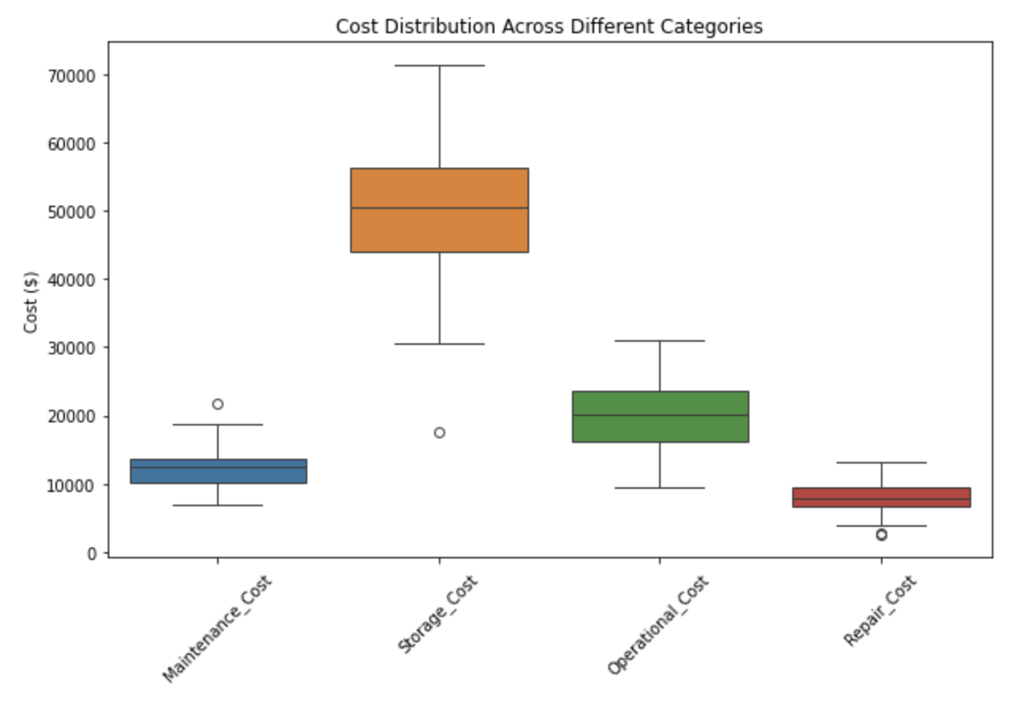
Data Visualization
Boxplot for Cost Distribution Across Categories
Illustrates the cost distribution across categories like Maintenance, Storage, Operational, and Repair, highlighting medians, variability, and outliers to identify areas for cost optimization.
*utilized synthetic data
Notes:
RAY

Slide 49
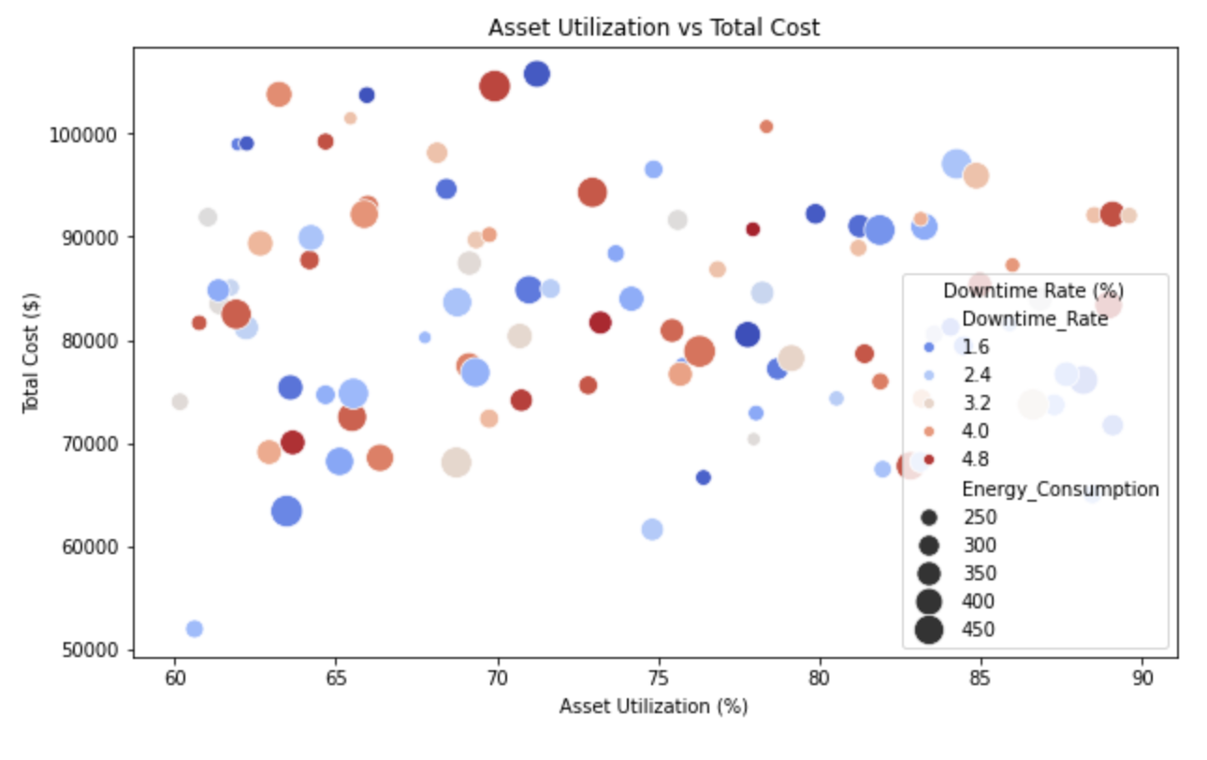
Data Visualization
Scatter Plot: Asset Utilization vs Total Cost
The plot shows Asset Utilization vs. Total Cost, with points color-coded by Downtime Rate (%) and sized by Energy Consumption (kWh), revealing cost-impact trends and assets needing attention.
*utilized synthetic data
Notes:
RAY

Slide 50
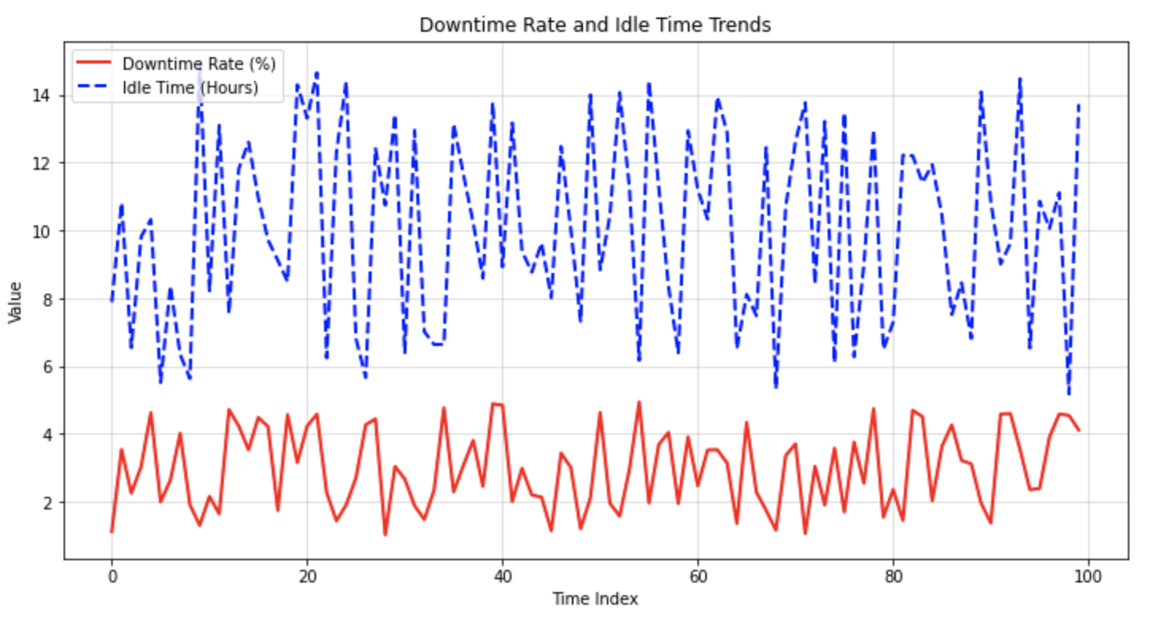
Data Visualization
Line Plot: Downtime Rate and Idle Time Trends
The trends of Downtime Rate and Idle Time over time. The red line represents Downtime Rate (%), while the blue dashed line indicates Idle Time (hours). This comparison helps track how these two metrics change together, enabling a better understanding of operational inefficiencies and the impact of maintenance schedules or policy changes.
*utilized synthetic data
Notes:
RAY

Slide 51
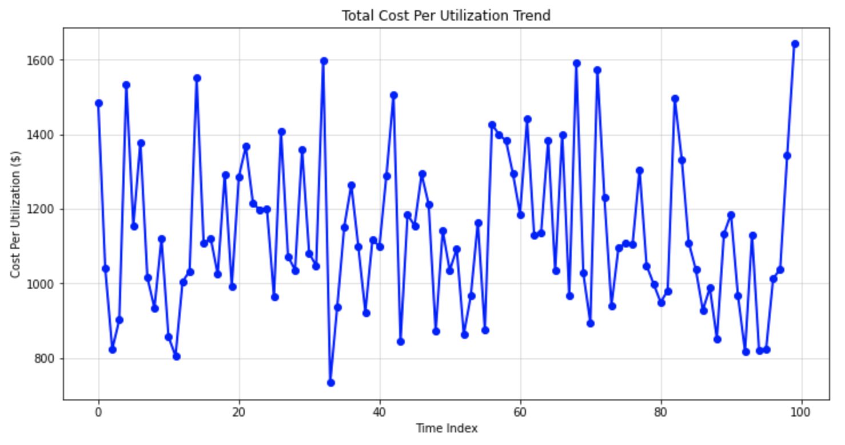
Data Visualization
Line Plot: Total Cost Per Utilization Over Time
The trend of Total Cost Per Utilization over time, calculated as Total Cost divided by Asset Utilization. This plot reveals how efficiently costs are managed relative to asset utilization. A downward trend would suggest improving cost efficiency, while an upward trend may highlight areas needing further investigation.
*utilized synthetic data
Notes:
RAY

Slide 52
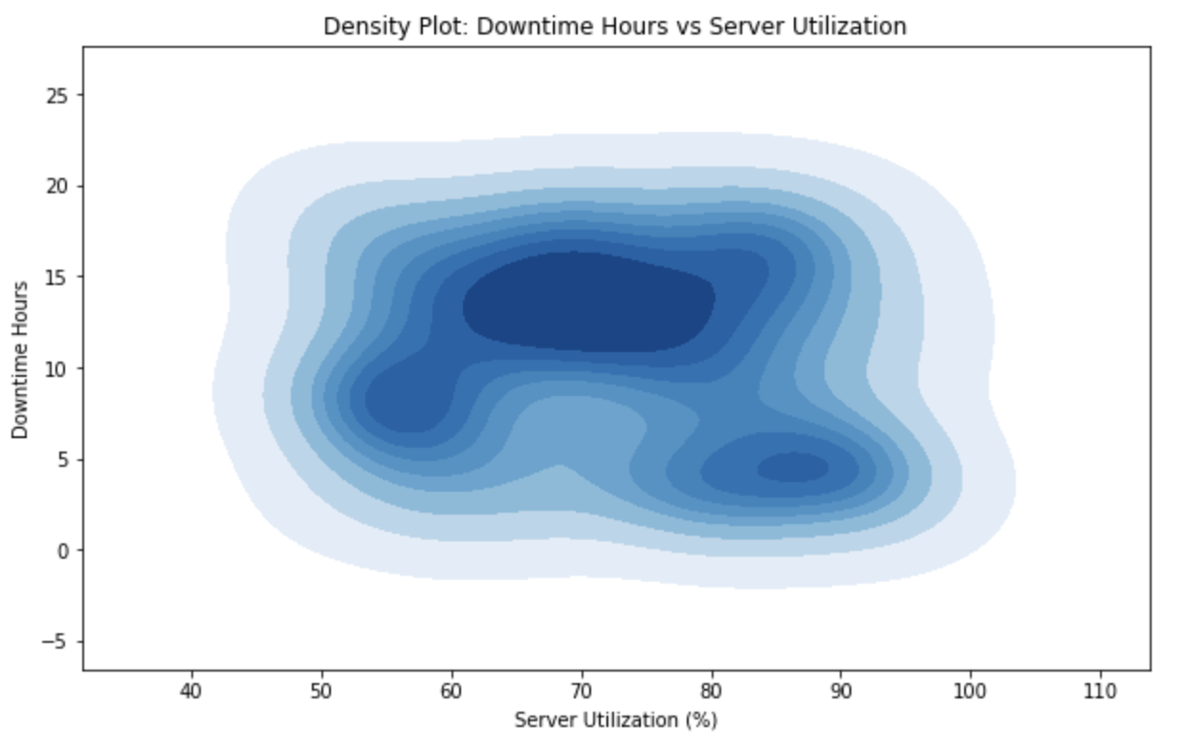
Data Visualization
KDE Plot: Downtime Hours vs Server Utilization
KDE plot visualizes downtime hours and server utilization, highlighting patterns like correlations between high downtime and low utilization. Peaks indicate common values, aiding in identifying inefficiencies.
*utilized synthetic data
Notes:
RAY

Slide 53
Optimization Strategies - Recommendation
01
Dynamic Resource Allocation
Use tools like AWS CloudWatch or Azure Monitor to automate resource scaling, balancing loads, and minimizing idle or overloaded systems.
Netflix optimized global server utilization to 75%-80% using dynamic resource allocation.
02
Use machine learning to analyze performance data and predict failures, and deploy AI tools like TensorFlow or PyTorch for forecasting and proactive maintenance.
GE's AI-driven predictive maintenance cut unplanned downtime by 30%, boosting asset reliability and efficiency.
Automation and Smart Tools
03
Use Kubernetes for dynamic load balancing to evenly distribute workloads, prevent overloading, and reduce idle resources.
Netflix uses Kubernetes to maintain 75%-80% server utilization, preventing overloads and ensuring stable performance.
Dynamic Load Balancing
Notes:
RAY

Slide 54
Security
“Benchmarking security in IT infrastructure involves assessing the effectiveness of security measures, policies, and practices against industry standards, regulatory requirements, or peer organizations. Identifies gaps, ensures alignment with best practices, and enhances resilience against evolving threats and protecting critical assets.”
Notes:
CHITRA
I’ll be talking about Security benchmarking. Security benchmarking involves comparing an organization's cybersecurity metrics against industry standards or best practices. It helps identify gaps, measure progress, and prioritize improvements to ensure the organization is well-equipped to handle threats effectively.

Slide 55



Security
USD 4.88M
Average Cost of a Data Breach
10% Increase Over Last Year
Notes:
CHITRA
Let’s first explore why security benchmarking is essential and why there’s an urgent need for it. A 2024 study by IBM and the Ponemon Institute revealed that the average cost of a data breach is $4.88 million, marking a 10% increase from 2023. This figure is based on insights from 604 organizations and 3,556 cybersecurity and business leaders who experienced breaches.

Slide 56
Security
$2.2 billion
Cybercrimes cost small and medium-sized businesses more than 2.2 billion dollars every year.
05
43%
of data breach victims are small businesses.
01
04
47%
of small businesses they have no understanding of how to protect themselves against cyberattacks.
95%
of cybersecurity attacks happen because of human error.
02
03
60%
of small businesses that suffer a cyberattack go out of business within six months.
Notes:
CHITRA
Data breaches have a significant impact on small businesses, often leaving them more vulnerable due to limited resources and security measures, sometimes even going out of business in 6 months. 95% of these attacks happen because of human error.
Given these alarming statistics, we have identified key areas within security for benchmarking, along with the critical metrics that must be tracked.

Slide 57
Security
Threat Detection and Response Time:
Mean Time to Detect
Mean Time to Acknowledge
Mean Time to Contain
Mean Time to Resolve
Virus Infection Monitoring
Frequency of scans
Detection rate of virus, malware, malicious code
Notes:
CHITRA
While organizations have security systems in place, threats and attacks remain inevitable. When these threats succeed, it is crucial for companies to act swiftly in identifying and mitigating them. Key metrics under threat detection and response include:
Mean Time to Detect (MTTD): This measures how quickly a threat is identified once it enters the system. A shorter MTTD minimizes the window of opportunity for attackers."
"Mean Time to Acknowledge (MTTA): This tracks the time it takes to confirm and act on a detected threat, reflecting the responsiveness of the cybersecurity team."
"Mean Time to Contain (MTTC): This measures how quickly the threat is isolated to prevent further damage."
"Mean Time to Resolve (MTTR): This represents the total time needed to completely mitigate the threat and restore normal operations.
Additionally, regular virus scanning plays a vital role in the prompt detection of potential threats or attacks.

Slide 58
Threat Detection & Response - Target Values
<1 hour
<270 days
Mean Time to Detect
Mean Time to Resolve
MTTD = Total detection time / number of incidents
MTTR = Total downtime / number of incidents
Notes:
CHITRA
A survey carried out in 2023 is a good representation of what average looks like regarding detection and response. They found that over 50% of organizations surveyed had a MTTD of less than 5 hours, with 25% of organizations having a MTTD of 60 minutes or less.
Managing risk is becoming more challenging as the number of vulnerabilities increases, often reaching thousands or more. Additionally, the average time to fix these issues has grown to about 270 days.

Slide 59

Threat Detection & Response
MTTD
MTTR
Notes:
CHITRA
Shorter detection and response times correlate with faster containment and recovery, essential for reducing damage and recovery costs. Virus Infection Monitoring can complement detection and response benchmarks by showing effectiveness in prevention. Reducing MTTR, MTTC, and MTTA should correlate with lower total costs.

Slide 60
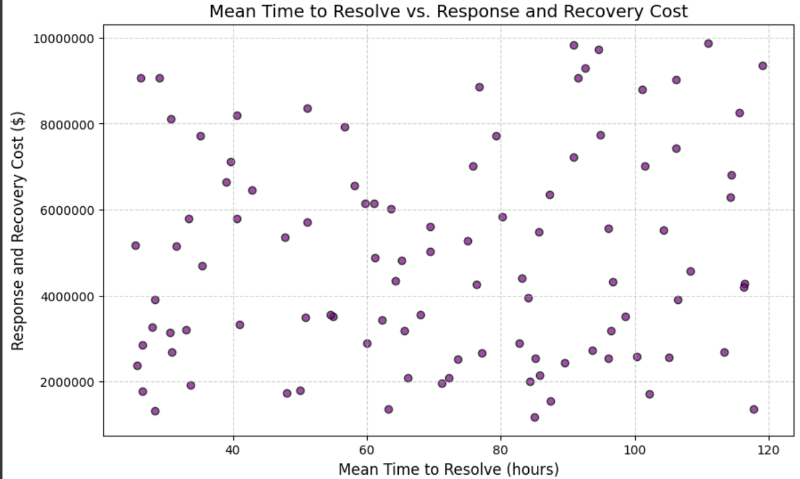
Threat Detection & Response
*utilized synthetic data
Notes:
CHITRA
This plot demonstrates a positive correlation between Mean Time to Resolve (MTTR) and Response and Recovery Costs, indicating that longer resolution times lead to higher costs.

Slide 61
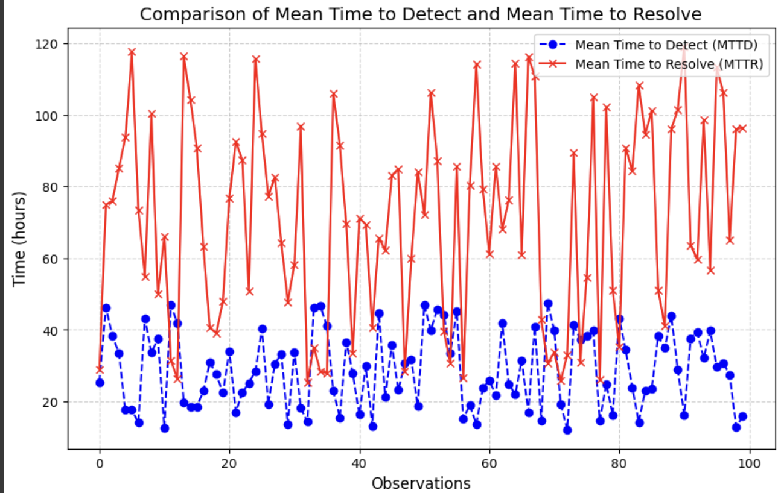
Threat Detection & Response
*utilized synthetic data
Notes:
CHITRA
The line plot highlights that the Mean Time to Resolve (MTTR) is consistently higher than the Mean Time to Detect (MTTD) across all observations, which is expected as resolution involves more steps.
Significant variability in MTTR suggests inefficiencies or complexities in resolution processes.

Slide 62
Security - Other Categories
Vulnerability and Patch Management
Data Loss Prevention and Access Control
Network and Endpoint Security
Security Awareness and Policy Compliance
Notes:
CHITRA
These are a few more areas we researched, which can help prevent these attacks:
Vulnerability and Patch Management: Ensures known security gaps are addressed promptly, preventing attackers from exploiting weaknesses.
Data Loss Prevention and Access Control: Protects sensitive information and restricts unauthorized access, reducing risks of data breaches.
Network Endpoint Security: Safeguards devices and networks from intrusions, ensuring secure communication and data integrity.
Security Awareness and Policy Compliance: Educates employees on best practices, minimizing human error and ensuring adherence to security protocols. The detailed KPIs and metrics are provided in the appendix section.

Slide 63
Challenges
Access to data
Uncovering new insights
Novelty Framework
Determining benchmark targets
Identifying a clear objective
Notes:
MBALI
We had a few challenges along the way. We found that it is quite difficult trying to build something novel.
Therefore some of our challenges include…
Trying to develop a novel framework came with countless meetings both internally and externally, back and forth messaging with the client, and advice from our faculty advisor.
Through our efforts and the support of TCS and our advisor, we were able to conduct great work as a team and provide a framework that may support TCS and its clients.

Slide 64
Lessons Learned - Reflections
“Innovation in the little things”
“It’s okay to ask for help”
“Not everything has a perfect ending, but we strive to make it our own”
“Verbose != Insightful”
Notes:
MBALI
Over the last 14 weeks, we learned a lot about collaboration and the difficulty of trying to develop something novel and innovative. In one of our most recent internal meetings, we reflected on all the work that we’ve done and a few quotes stood out
These quotes represent our progress, appreciation of our efforts, and an overall reflection of our collaboration as a team.

Slide 65
Next Steps
Utilization of Industry Data
Continued Development
Training of Framework Model
Testing & Deployment
Incorporate industry data into the benchmarking framework, aligning it with internal metrics to enable meaningful comparisons.
Develop the framework to handle variations across industries, organizational sizes, and technological landscapes.
Integrate tools and automation to facilitate real-time benchmarking and reporting.
Train the model using historical and real-time data to establish benchmarks, detect anomalies, and predict trends.
Test the framework with simulated data scenarios to ensure it accurately identifies performance gaps and provides actionable insights.
Roll out the framework organization-wide.

Slide 66
Thank you!
X
Mbalenhle B. Holt | Pengrui Zeng | Pranav Naik | Abhineet Chaudhary | Chitra R. Krishnarao
Faculty Advisor: Allison Sagraves
Notes:
MBALI

Slide 67
Q&A

Slide 68
References
Implement Efficient Data Storage Measures | ENERGY STAR.
Latency critical big data computing in finance - ScienceDirect
Understanding Network Latency and Its Impact on Industrial Applications
RTO (Recovery Time Objective) and RPO (Recovery Point Objective) | Knowledge Center | Commvaul
Competitive Infrastructure Benchmarking | Trianz
How much does it cost to build a Generative AI?
How to Calculate Business Value and Cost for Generative AI Use Cases
How much is the cost of building generative AI applications?
The Extreme Cost Of Training AI Models Like ChatGPT and Gemini
KPIs for gen AI: Why measuring your new AI is essential to its succes | Google Cloud Blog
APIs: The Key to Generative AI Success and Security
34 AI KPIs: The Most Comprehensive List of Success Metrics

Slide 69
References
Predicting Customer Lifetime Value with AI Platform: training the models | Google Cloud
A Metrics-Driven Approach to Evaluating GenAI Use Cases in the Finance Function.
Economic potential of generative AI | McKinsey
Calculating the Cost of Generative AI — ITRex
Technology Spotlight — Accounting for the Development of Generative AI Software Products (October 7, 2024) | DART
What Is Return on Investment (ROI) and How to Calculate It
How to Measure the ROI of GenAI Investments? - Analytics Vidhya
The path to generative AI value: Setting the flywheel in motion
Index Insider: Generative AI Use Cases – Where’s the Top Line? | ISG

Slide 70
APPENDIX

Slide 71
Purpose Continued
Application Performance
Tool: SPECjEnterprise2010
Purpose: Performance of a representative Java EE application
Workload: Automobile dealership simulation
Metric: Enterprise jAppServer Operations Per Second ("SPECjEnterprise2010 EjOPS")
SPECjEnterprise2010 EjOPS = Dealer Transactions/sec + Workorders/sec
Notes:
CHITRA

Slide 72
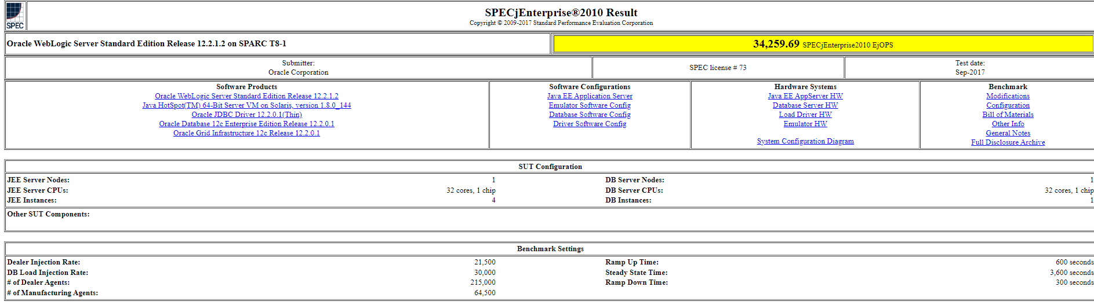
Purpose Continued
Application Performance
Notes:
CHITRA

Slide 73
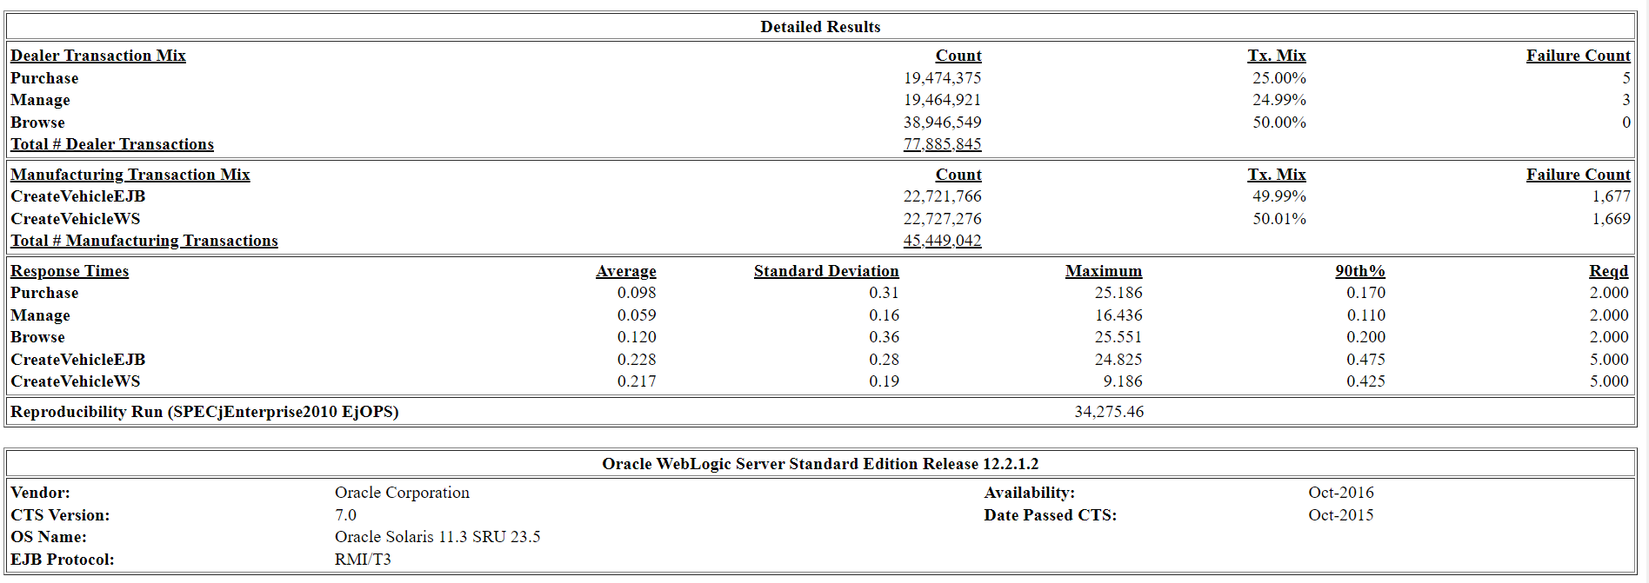
Purpose Continued
Application Performance
Notes:
CHITRA

Slide 74
Purpose Continued
Performance Comparison
Enables organizations to assess their performance against industry standards and competitors.
05
Support Decision-Making with Data
Provides data-driven insights to guide strategic planning and operational decisions.
01
04
Monitor Progress Over Time
Tracks performance trends to evaluate improvements or declines over specific periods.
Identify Gaps and Opportunities
Highlights specific areas for improvement and potential growth based on performance metrics.
02
03
Personalized Suggestions
Provide actionable recommendations based on the KPIs
Notes:
CHITRA

Slide 75
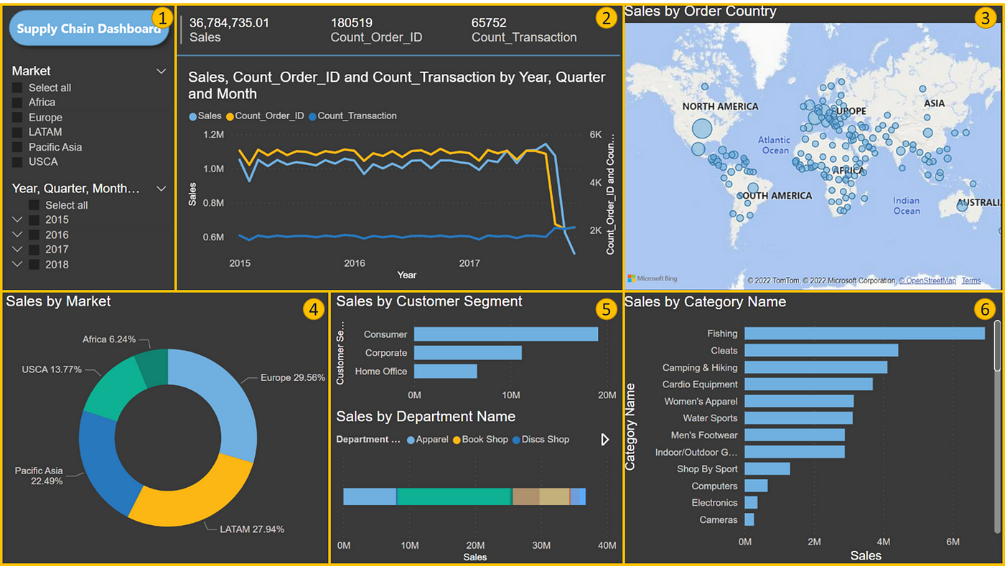
Industry Benchmarking Tool Features
Analytical
Competitive Intelligence
User Testing
Extract Transform Loading (ETL)
Predictive Analysis
Data Visualization
Machine Learning (ML)
Notes:
PRANAV

Slide 76
Benchmarking Research
BENCHMARKING AREAS | RESEARCH TOPICS
Product | External vs. Internal Analysis Current Benchmarking Tools Key Metrics Key Performance Indicators (KPIs) Public Data Reports Benchmarking Goals Industry Leaders
Operations
Financial
IT Infrastructure
Performance
Notes:
PRANAV

Slide 77
Industry Benchmarking Tools
Some notable benchmarking tools available on the market.
BENCHMARKING AREAS | TOOLS
Product | Mixpanel, Flurry, Crayon, Asana
Operations | PowerBI, ARIMA, XGBoost
Financial | Sage Intacct, Yahoo Finance, Dun and Bradstreet
IT Infrastructure | Apptio Cloudability, ServiceNow, Qualys
Performance | SPEC CPU 2017, PassMark Software - MemTest86
Notes:
PRANAV

Slide 78
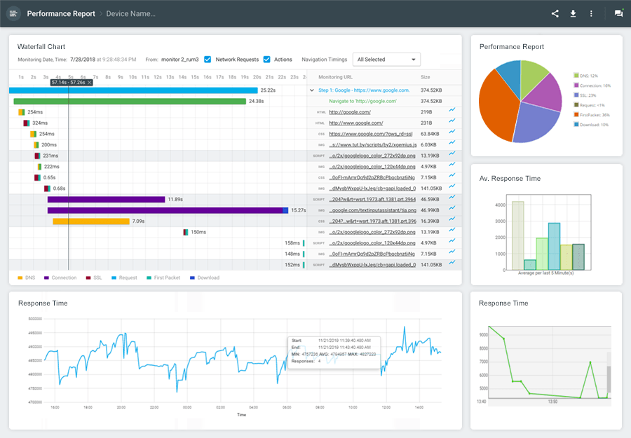
IT Infrastructure Benchmarking
Performance Benchmarking
Measures the speed, uptime, or efficiency of IT systems
Metrics:
Availability
Consistency
Incident Resolution
Transactional Volume
Response Time
Common Benchmarking Tools:
Sysbench
Iperf
Geekbench
Notes:
ABHINEET

Slide 79
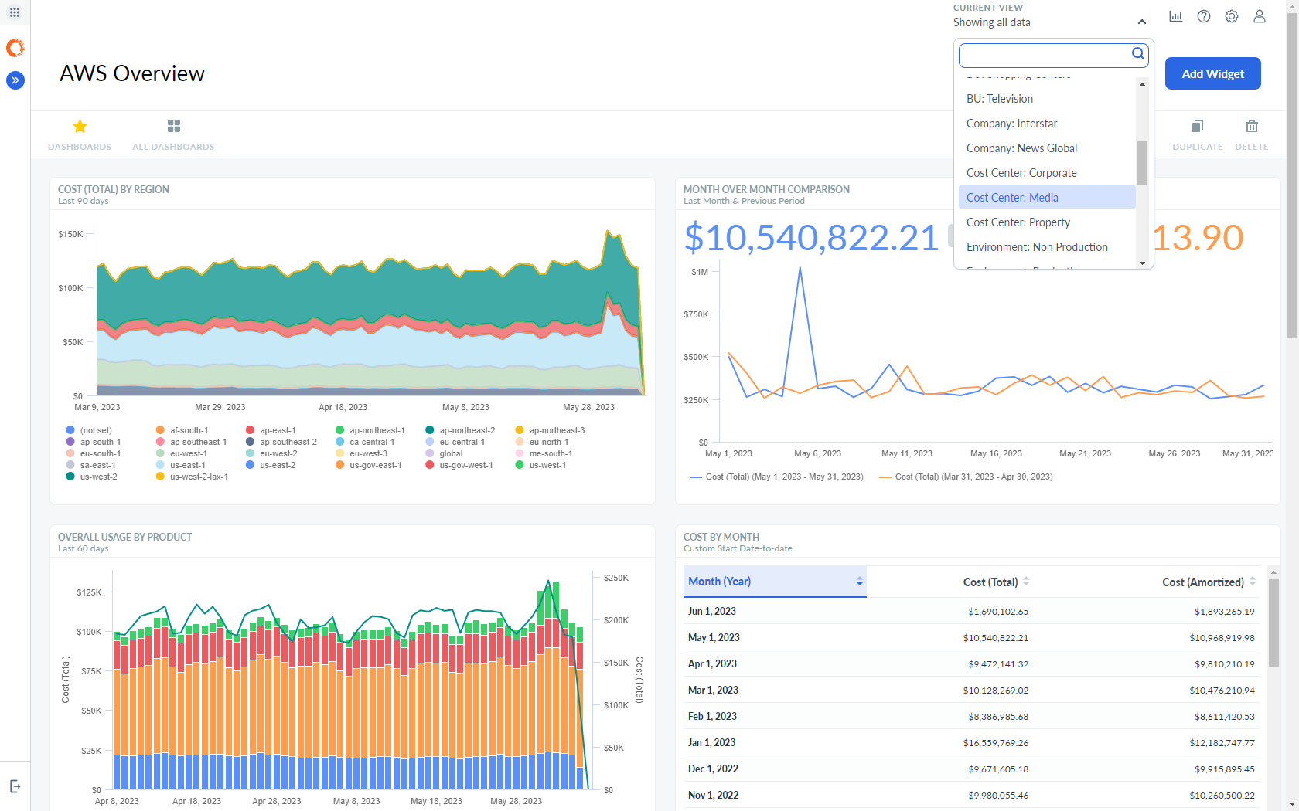
IT Infrastructure Benchmarking
Cost Efficiency Benchmarking
Compares IT spending and budgeting against industry norms to ensure cost-effectiveness
Metrics:
Budget Variance
Average Resource Cost
Costs per activity
Labor Cost
Common Benchmarking Tools:
Apptio
CloudHealth by VMware
Ternary FinOps
Notes:
ABHINEET

Slide 80
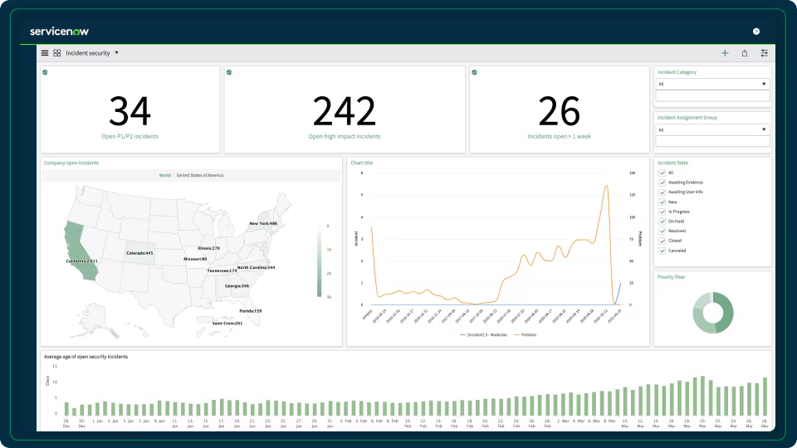
IT Infrastructure Benchmarking
Process Benchmarking
Looks at the efficiency of IT workflows and processes
Metrics:
Value realization
Delivery timelines
Common Benchmarking Tools:
ServiceNow
Notes:
ABHINEET

Slide 81
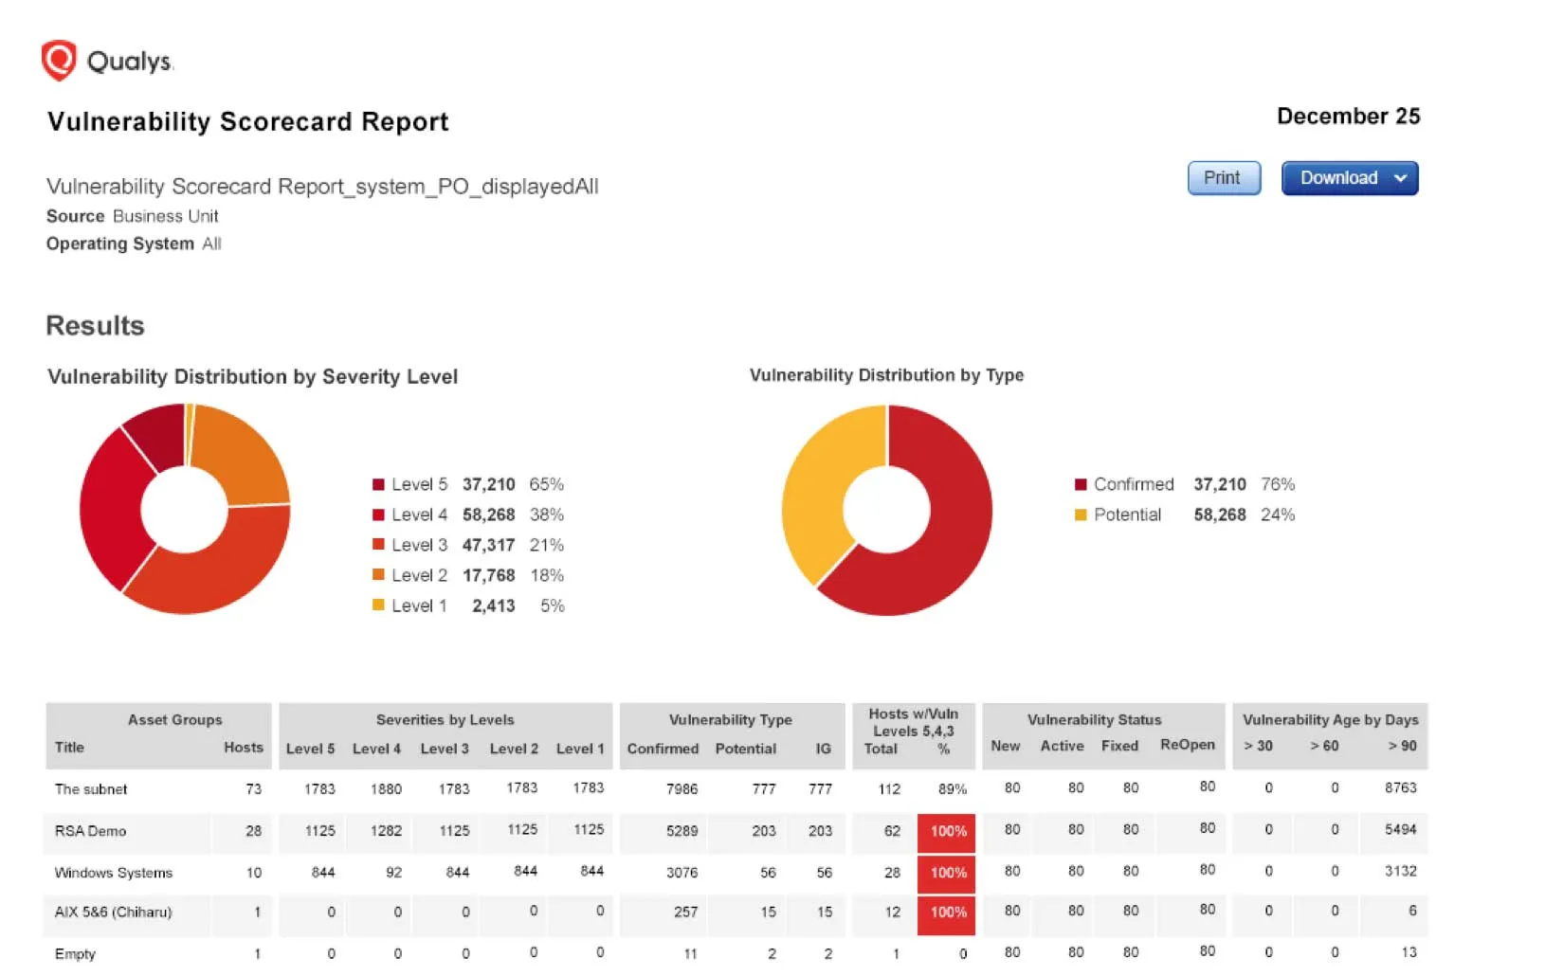
IT Infrastructure Benchmarking
Security Benchmarking
Evaluates security measures and adherence to industry best-practices
Metrics:
Encryption Standards
Vulnerability Management
Common Benchmarking Tools:
Nessus
Qualys
Notes:
ABHINEET

Slide 82
Security
Vulnerability Patch Management:
Patching Rate
Average Open vs Closed Vulnerabilities based on severity rate
Vulnerability ratings: Critical, High, Medium, Low, and None
Scan Rate
Mean Time to Detect
Mean Time to Resolve
Business Unit Risk Score
Vulnerability Maturity
Average Number of Granted Exceptions
Average Audit Score
Patch Prioritization Based on Vulnerability Rating

Slide 83
Security
Data Loss Prevention and Access Control
a. Data Loss Prevention Effectiveness
i. Incident Prevention Ratio
ii. DLP response time
iii. False positives and negatives
b. Access Management

Slide 84
Security
Network Endpoint Security
a. Non-human traffic
b. Network Security Rating ( a score between A and F)
c. Intrusion attempt vs. actual incidents

Slide 85
Security
Security Awareness and Policy Compliance
a. Number of cybersecurity incidents reported
b. Security awareness training completion
c. Incorrect SSL configurations
d. Data Transferred via corporate network

Slide 86
Purpose Continued
Comprehensive Research for KPIs: KPIs vary depending on the domain within the selected industry, ensuring that each performance metric is tailored to its specific context.
Application Performance: # transactions / second
System Scalability: Memory, Throughput
Prevent duplication of tasks: Once the KPIs for a particular industry are determined, they only need periodic updates, avoiding repetitive efforts in re-establishing metrics.
Notes:
CHITRA

Slide 87
Purpose Continued
Eliminate Manual Errors: The tool ensures no KPIs or metrics are overlooked, avoiding costly manual mistakes and test redesigns.
Eg: SPECjEnterprise2010 which is meant to test the application server stresses the database server as well
Instant feedback: Provides real-time performance insights, showing where organizations excel or need improvement, with industry benchmark comparisons.
Notes:
CHITRA

Slide 88
Business Impact Continued
Increased operational efficiency: Automating research and testing streamlines operations, minimizing manual intervention and reallocating resources to high-priority tasks.
Cost savings and resource optimization: By eliminating manual errors and redundant processes, organizations achieve significant cost savings and optimize manpower usage.
Notes:
CHITRA

Slide 89
Business Impact Continued
Enhanced Strategic Planning: The tool delivers actionable insights that empower companies to align their improvement strategies with industry benchmarks and long-term goals.
Competitive Advantage: Continuous monitoring of performance metrics helps organizations identify improvement areas swiftly, ensuring they remain ahead of industry trends.
Notes:
CHITRA

Slide 90
Business Impact Continued
05
Time Savings for Key Resources
The tool saves time for key resources by automating repetitive tasks and allowing focus on strategic initiatives.
Increased Efficiency
The tool automates tasks to streamline processes, enhancing overall operational efficiency.
01
04
Improved Decision-Making
The tool enhances decision-making by delivering accurate insights and analytics.
Cost Reduction
The tool reduces operational costs by minimizing resource utilization and manpower.
02
03
Minimized Manual Errors
The tool decreases the likelihood of human errors through automated data handling.
Notes:
CHITRA

Slide 91
Solution
“Develop a novel framework surrounding IT Infrastructure benchmarking by analyzing how the data is utilized. Through data and metric evaluation, determine where missing intel may exist that is currently not being considered in today’s benchmarking landscape.”
Notes:
CHITRA

Slide 92
Solution Continued
05
Comprehensive Research
Periodic Updates
01
04
Build Tool to Provide Personalized Feedback
Identify KPIs and Metrics
02
03
Determine Industry Standards
Notes:
CHITRA

Slide 93
Benchmarking Areas, Metrics & KPIs
Product
Operations
Financial
IT Infrastructure
Performance
Activation Rate
Free-to-Paid Conversion
User Retention
Feature Adoption
Product stickiness
Net Promoter Score (NPS)
Churn Rate
Inventory Turnover Rate
Production Efficiency
Order Fulfillment Time
Operational Costs
Supply Chain Efficiency
Delivery Time
Downtime
Maintenance Time
Revenue Growth Rate
Profit Margin
Return on Equity (ROE)
Debt-to-Equity Ratio
Return on Investment (ROI)
Operating Expenses to Revenue Ratio
Application Performance
System Scalability
Memory Diagnostics
Availability
Incident Resolution
Transactional Volume
Value Realization
Delivery Timelines
Encryption Standards
Vulnerability Management
Notes:
PRANAV

Slide 94
Selection of a Benchmarking Focus
Select Desired Benchmarking Focus
Based on all findings and analysis, determine the most appropriate benchmarking area to focus to meet the client’s expected end result
1
Compare Pros & Cons
Determine the feasibility and overall impacts of each benchmarking area
2
Evaluate Metrics and Data Availability
Analyze the accessibility to key data of area as well as current industry metrics
3
Compare Benchmarking Standards
Compare all benchmarking and industry findings against one another
4
Initial Research
Conduct research of each benchmarking area
5
Notes:
Speaker: ABHINEET

